Slide 1
Understanding Diverse Learners: Children in Poverty Plan
Student’s Name
Institutional Affiliation
Date

Slide 2
Poverty in Minnesota
The mock student I selected come from Minnesota state.
The rate of poverty in Minnesota has significantly increased over years.
It has been rated among the fifth states with highest number of people living in poverty.
Approximately 10% of people of all ages live in poverty.
About 12% of children under the age of 18 experience poverty in the state.
Therefore, at least one in nine children in Minneapolis live in poverty.

Slide 3
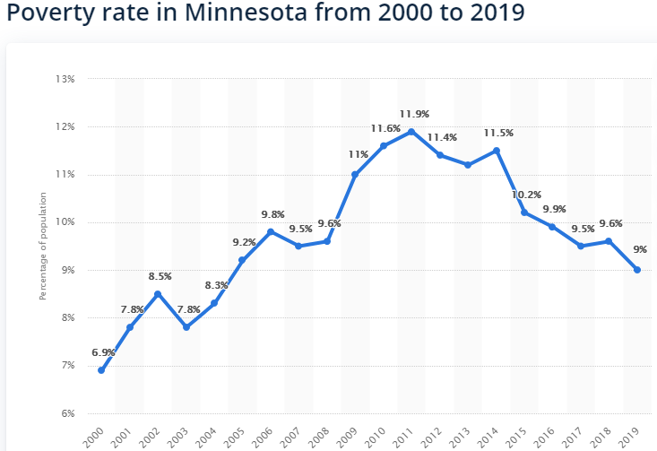
Representations of the level of poverty in Minnesota

Slide 4
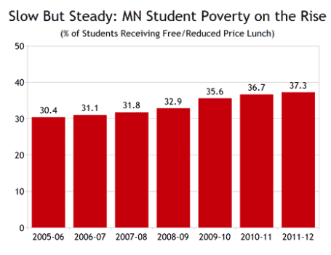
representations of the level of poverty in your Mock Student List

Slide 5
Strategies to Address Poverty Among the ELL Students
Unfortunately, statistics shows that ELL students have higher prevalence of poverty in Minnesota.
To help eradicate or lower this rate, the government of the state should;
Implement Inequitable Funding Mechanisms- this will ensure that students who have the greatest needs get the enough resources.
The government should implement local flexibility- to direct much-needed resources to public schools serving children in poverty.

Slide 6
Appropriate Model of Student Integrated Support
According to Cardinali video majority of our nation's K-12 students are living in poverty and are systematically lacking the external supports they need to succeed in school
Cardinal video “Why Most Students Are Getting the Least Out of School” the most appropriate model of Student Integrated Support would be to weave Integrated Student Supports into the very design of public education in order to drive students' holistic development.
As a teacher, I would use this modal to my mock students in poverty.

Slide 7
References
Tomlinson, C. A. (2000). What is differentiated instruction?Retrieved from http://www.readingrockets.org/article/what-differentiated-instruction
Poverty and Education: From a War on Poverty to the Majority of Public School Students Living in Poverty PDF
Cardinali Dan. (2015). Why most students are getting the least out of school [Video]. YouTube. https://www.youtube.com/watch?v=qzALINIvYNQ

